Slide 3
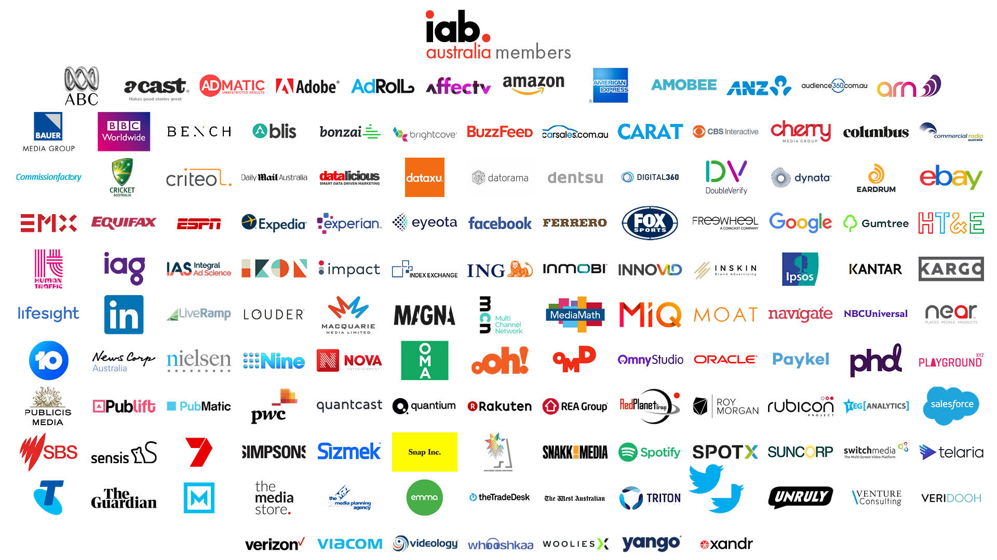

Slide 5
Creating an Improved Marketplace Through Industry Collaboration
@
Dennis Buchheim
EVP & GM, IAB Tech Lab

Slide 6
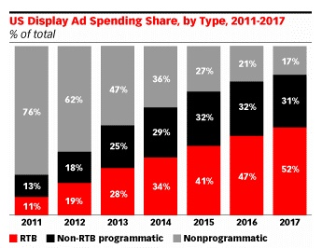
Why We’re Here: A “Perfect Storm” of…Opportunities
Growth & evolution of automation…
…has come with challenges:
Consumer backlash
Privacy regulation
Brand safety
Measurement
Fraud
Transparency
Infrastructure costs
And more…
Non-Programmatic
Programmatic
Source: eMarketer. And while this chart shows US growth, the pattern globally has been similar if not more dramatic.

Slide 7
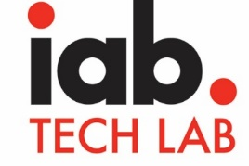
How We, as an Industry, Meet These Challenges
Education & certification
Research
Best practices & guidelines
Public Policy
Events & networking
Market Development
(supporting sales/marketing)
Product/service development
Packaging & pricing
Sales & operational excellence
Competition
Proprietary
Innovation
Member Companies
“Ingredients”
(supporting product development)
Standardized protocols & specifications
Software & tools
Compliance programs
Supporting education & events

Slide 8
How IAB Tech Lab Helps – Our Mission
Sharing the cost, sharing the benefits
Member-driven, member-developed
Engage a member community globally to develop foundational technology and standards that enable growth and trust in the digital media ecosystem.
Broad availability & utility, by design
We live this – as a neutral, transparent, open-source, non-profit org
8

Slide 9
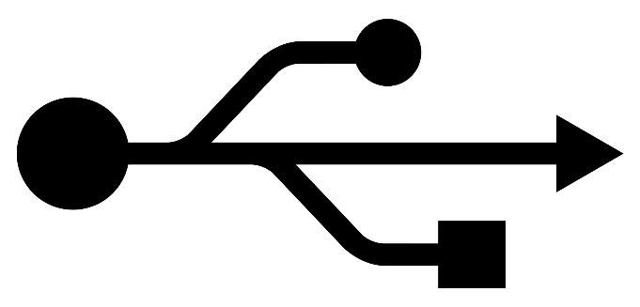
We All Rely on Technical Standards Every Day
USB
Tech Lab standards are similar…but for digital media.
Standards & compliance help our industry:
Reduce engineering/product effort & costs
Improve interoperability & quality
Increase speed to market
Fuel market innovation
…and grow!

Slide 10
Global Community, Creating Global Standards
*
*
*
*
*
*
*
*
*
*
*
*
*
*
*
*
*
*
*
*
*
*
*
*
*
*
*
*
*
*
*
1,000+ companies
30 working groups
2,000+ people
*
*
*
*
* Local/regional IABs supporting Tech Lab
*
*
*
*
*
*
*
*
Board
of Directors

Slide 11
Tech Lab Themes & Standards Portfolio
Brand Safety & AD Fraud | Identity, Data, & Consumer Privacy | Ad Experiences & Measurement | Programmatic EFFECTIVENESS
ads.txt / app-ads.txt | DigiTrust ID | VAST (4.2) | OpenRTB (3.0)
sellers.json | OTT IFA Guidelines | SIMID (VPAID vNext) | sellers.json
SupplyChain object | Identity Validation Guidelines | MRAID | SupplyChain object
ads.cert | Data Label | New Ad Portfolio | OpenDirect
Content Taxonomy | Audience Taxonomy | Dynamic Content Ads | Ad Management API
Ad Product Taxonomy | OpenData | SafeFrames
Open Measurement (IVT filtering) | Transparency & Consent Framework (IAB Europe) | Open Measurement
TAG engagement | PrivacyChain | OTT IFA Guidelines
 |  | Podcast Measurement Guidelines | …and Blockchain!
BOLD = Highest priorities for adoption now

Slide 12
Three Topics Today…
Identity & Privacy
Brand Safety & Ad Fraud
Video Ad Experiences

Slide 13
IDENTITY & PRIVACY

Slide 14
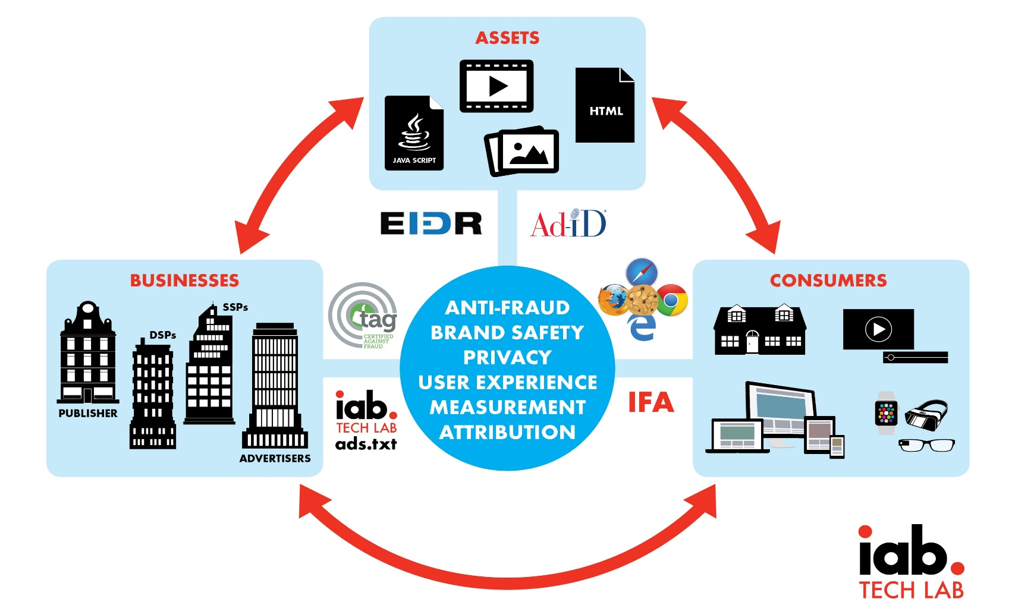
Background: Identifiers in Advertising

Slide 15
Consumer IDs – Biggest risk or biggest opportunity?
A more focused “perfect storm” within our industry…
With several factors growing and feeding upon each other:
Proliferation of personal, connected devices (phones, smart homes, speakers, etc.)
Scale of personal data collection and use…and potential for misuse
Consumer expectations related to privacy, transparency, control
Government regulation of consumer privacy, transparency, control
Blocking of identifiers by browsers, operating systems, add-ons (#tracklash)
“Privacy”-motivated PR and legal attacks on our industry

Slide 16
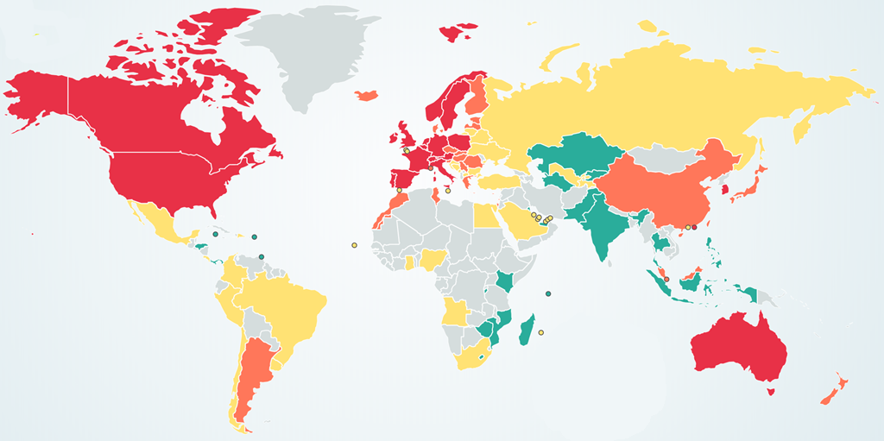
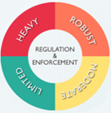
Privacy – Global Regulatory Landscape
Many countries/regions are moving towards privacy laws. Most have “GDPR-like” features…notably, consumer consent requirements.
Tech Lab co-developed Transparency & Consent Framework for GDPR with IAB Europe.
We’re underway with discussions about technical solutions for California/US privacy laws…
Source: www.dlapiperdataprotection.com

Slide 17
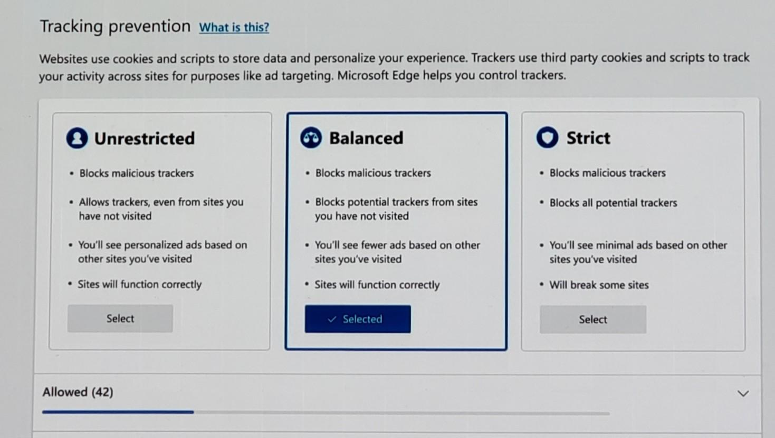
Recent Announcements: Microsoft Edge Browser

Slide 18
Recent Announcements: Chrome & Google Ads
Chrome’s next steps towards transparency & control:
Push for cookies to self-declare intentions (1p or 3p via “SameSite”)
Simple tools coming for users to manage & clear cross-site cookies
Protections against fingerprinting
Likely only the beginning for Chrome (agree or disagree?)
Google Ads & data disclosure:
Plans to share with consumers details about the data used to target & personalize ads – a la “data nutrition label”, via browser extension
Opportunity to align with our Data Label effort

Slide 19
So… What are we doing about this?
Track | Status | Current Goal
Top-down engagement with browsers | ✅ | Pursue long-term peace with browsers
DigiTrust ID Service | ✅ | Strengthen our product positioning
Bottom-up engagement with browsers (W3C) | 🤔 | Listen, educate, inform
Privacy for America, DAA, AdChoices | ✅ | Inform & encourage US Federal legislation; seek opportunities for collaboration
Regional/National privacy action | ✅ | Collaborating with local IABs
DAA, AdChoices, other self-regulation | ✅ | Increasing collaboration
Advertising ID Consortium & others | ❓ | Seeking opportunities for collaboration
TRACK 1
TRACK 2

Slide 20
TRACK 1: Our “Browser Bets” …
… and what we feel is necessary for browsers to work with our industry (instead of protecting consumers from our industry).
Based on initial meetings with:
Google Chrome
Microsoft Edge
Mozilla Firefox
(Have not reached out to Apple Safari recently.)

Slide 21
Browser Bet #1: Status Quo is Not Realistic ...
100s of disparate 3rd-party cookies or probabilistic IDs.
Billions of redundant “trackers” (ID syncs) on pages to connect them.
Fragmented consumer control over privacy.
No accountability or single source of truth for 3rd-party ecosystem.
Opaque consumer data collection, sharing and use.

Slide 22
Browser Bet #2: They Will Not Simply Provide an IFA
Browser ID
3rd party
3rd party
3rd party
3rd party
3rd party
3rd party
Website.com
3rd party
3rd party
3rd party
They won’t facilitate broad consumer data collection, sharing and use.
They won't take on the privacy risk.
They can’t trust the 3rd-party ecosystem.
They won’t take on a compliance program.
“Mobile device IDs” is not a rationale.

Slide 23
Browser Bet #3: Mobile Device IDs May Be Next to Go
IDFA
3rd party
3rd party
3rd party
3rd party
3rd party
3rd party
Mobile App
3rd party
3rd party
3rd party
ToS is between O/S and App Developers, not third parties.
Third parties are using IDFAs in violation of terms.
(But one thing at a time … easier to solve Web than App!)

Slide 24
Browser Bet #4: They Will Respect “True” 1st Parties
Website.com
1st-party cookies are safe. (Use in a 3rd-party context is not.)
1st parties will be able to set/use persistent identifiers.
Consumer transparency and control is critical.

Slide 25
Browser Bet #5: They Won’t Accept “a Handful of Cookies”
3rd party
3rd party
3rd party
3rd party
Website.com
3rd party
3rd party
Reduction to “handful of 3rd-party cookies” does not address the trust issues.
They won’t pick winners and losers within third-party ecosystem.
All the 3rd parties win or lose together!

Slide 26
Browser Bet #6: Consumers & 1st Parties Will Gain Control
ID + privacy preferences earned & set
ID token + privacy preferences propagated & respected
1st parties earn consumer trust, establish privacy preferences attached to a standardized token (“ID for Advertising”), in accordance with correct policy.
Consumers have central point of control over their privacy, which propagates to 3rd parties.
3rd parties must honor and propagate consumer preferences as a condition to using the token. Standardized ID token coupled to preferences provides accountability and trust, and enables improved compliance.

Slide 27
Browser Bet #7: A Standardized ID Token Is Needed
We believe the following to be very important to browsers:
Global, neutral, single device (not cross-device)
Simple to understand consumer privacy settings
Controlled distribution and use of a revocable ID token
Privacy preferences directly coupled
Access tied to compliance
Revocation result of non-compliance
Industry accountability and self-policing
Ongoing technology mechanisms to quickly surface non-compliance
Annual compliance review?
Stands up to scrutiny by regulators and privacy advocates

Slide 28
TRACK 2: DigiTrust ID Persistence
Evaluation criteria:
Privacy and consent
User experience
Governance
Accuracy
Simplicity
Resilience
A consumer-facing dialog was considered the most feasible, though would require:
Developing a DigiTrust user dialog; or
Working with consent management providers, etc.
Our goal in TRACK 2 is to find solutions to the defined problem space, using existing browser technology, and without disruption to TRACK 1.

Slide 29
Commonalities of TRACK 1 & TRACK 2
Both inherently depend on:
Standardized mechanism for audience recognition
Revocable; access tied to respecting privacy preferences
Consumer transparency and control
Privacy settings for consumers, respected and propagated
Industry accountability and compliance
Rebuilding trust in our industry
This is most urgent; we now have a group working on it.

Slide 30
We Must Solve Privacy-friendly Consumer Identity
Without a solution, we face:
Unreliable, inconsistent privacy preferences for consumers
Limited targeting & personalization for buyers
Incomplete measurement & attribution for buyers
Wasted spend for advertisers & less revenue for publishers
Challenges fighting fraud for all of us (more later)

Slide 31
Brand Safety & Ad Fraud

Slide 32
Background: Brand Safety vs. Ad Fraud
CONTEXT
FRAUDULENT TRAFFIC
BID DATA SPOOFING
BRAND
SAFETY
AD
FRAUD
PIRACY
ON-PAGE TRICKERY
MALWARE
TRAFFIC
INTERMINGLING
PRIVACY
IMPRESSION
THEFT
Notes:
Brand Safety defined as

Slide 33
Transparent & Secure Programmatic Transactions
PUBLISHERS
SSPs
OTHER AD TECH
DSPs
ADVERTISERS & AGENCIES
OpenRTB Transaction
(real-time buying/selling)
ads/app-ads.txt
(auth. sellers)
sellers.json
(identified sellers)
Verify auth sellers
SupplyChain Object
(record of sellers via bid requests)
ads.cert
(signed bids)
Verify ads.cert
Open Measurement
(viewability+)
Measure Viewability & Fraud
Data Label & Taxonomies
DigiTrust & OTT IFA (consumer identity) & GDPR (privacy)
= Signals sent through supply chain

Slide 34
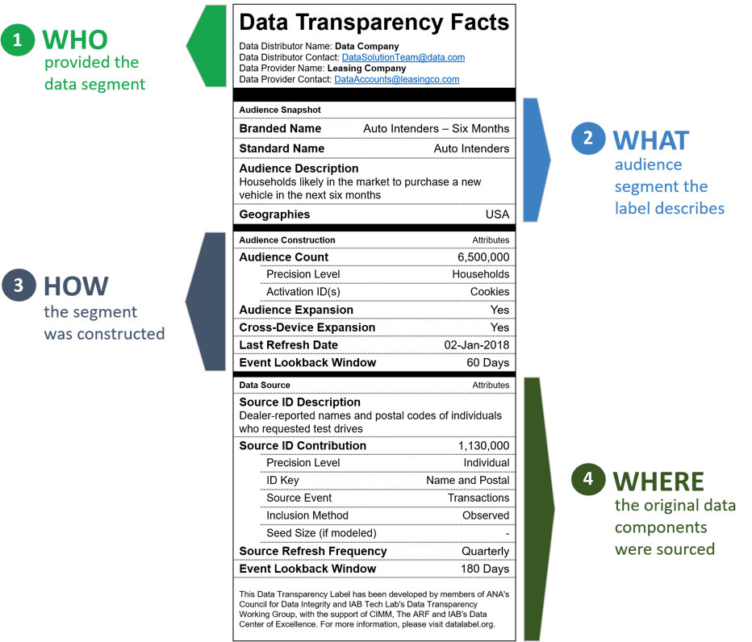
Some Detail: Data Transparency
On Oct 1, Tech Lab, ANA/DMA, ARF/CIMM, IAB announced a joint effort to establish audience data segment disclosure standards.
Provides info to help buyers make more informed purchase decisions: age, provenance, other segmentation criteria
Labels hosted at datalabel.org
Relates to Tech Lab’s Data Transparency Stds. from May
Roadmap:
Q1 2019 – collect & incorporate broader buyer & marketplace feedback
Q2 2019 – full launch of datalabel.org platform + compliance program
Destination that stores labels from participating data sellers
Query-able database that delivers labels to DSPs or DMPs
Compliance program that validates business processes & technical infrastructure used to deliver labels
34

Slide 35
Video Ad Experiences

Slide 36
Industry Requirements
Verification
Delivery
Interactivity

Slide 37
Simplifying Video Advertising
Current
Future
VAST Tags
VAST 4.x
VPAID Tags
Custom Tags
VPAID
OMID
MRAID
Custom SDKs
VPAID
SIMID
Custom SDKs Tags
MRAID

Slide 38
Future of Video Ad Serving
OMID (Verification)
VAST 4 (Delivery)
SIMID (Interactivity)
Notes:
To re-iterate…

Slide 39
Collaboration

Slide 40
IAB Tech Lab Working Groups – How Work Gets Done
Our working groups are comprised of the industry’s best engineering and product minds. They engage hands-on to develop standards and software to realize Tech Lab’s mission and agreed strategies.
Ad Product Portfolio
Blockchain
Data Transparency Standards
Digital Video Technical Standards
DigiTrust ID
GDPR Technical Working Group
Header Tag Task Force
IAB Dynamic Content Ad Standards
Identity Standards
LEAN, DEAL & Experiences
Mobile Rich Media Ad Interface Definitions
Modernizing Measurement Task Force
MRAID Ads SDK Tester
Open Measurement
OpenData Task Force
OpenDirect
OpenRTB Native
OpenRTB
OpenVV
OTT Technical Working Group
Podcast Technical Working Group
SafeFrame Implementation
Taxonomy and Mapping
TV Convergence Technical Task Force
Video Tools & Best Practices (sub-group of Digital Video Tech Standards)
+ Tech Lab Council (interest group open to all TL members)

Slide 41
Events for Your Product & Tech Teams
TECH LAB INNOVATION DAYS
Full-day deep dives into technology and standards within Tech Lab theme areas. Industry leaders and influencers share insights into effective standards implementation and troubleshooting, related new solutions, and scaled innovation through standards.
May 6: Transparency & Securing the Supply Chain
Sept 19: Data Responsibility
Nov 12: Ad Experiences & Measurement
TECH LAB OPEN FORUMS
Half-day events providing updates on working groups progress and plans and deep dive into the technical details of industry protocols and standards supported by member companies showcasing their reference implementations, closing out with open Q&A session and a look at what the future roadmap will hold.
April 15: Supply Chain / Programmatic
June 6: Data
July 23: Ad Experiences & Measurement
May 7: Blockchain
Oct 20 (Tentative): Video
+ EDUCATIONAL WEBINARS
TECH LAB SESSIONS @ OTHER EVENTS
IAB US
IAB Europe
IAB Spain
IAB France
IAB UK
IAB Australia
China TBD
ATS Madrid, Singapore, London
AdMonsters
DMEXCO
NAI
Podcast Movement
Programmatic I/O
TVOT

Slide 42
We CAN Improve Our Industry Together. Please Join Us!
Tech Lab membership means:
DRIVE ROI | Gain early access to standards & products that will drive your business
INFLUENCE THE INDUSTRY | Participate in our groups, be recognized for contributions
CONNECT WITH PEERS | Network with 500+ member companies
BUILD TRUST | Adopt standards that help increase your business’ trust & transparency
BE EMPOWERED | Access code repositories, with option to contribute
LEARN & BE INSPIRED | Gain special access to industry events, webinars, trainings
ACTIVATE WISELY | Sponsor highly-targeted industry events
ENJOY DISCOUNTS | Save, with preferred pricing on Tech Lab products & services

Slide 43
Thank you!
dennis@iabtechlab.com

